Slide 1
Analysis of accidents in UK
(2005-2014)
Ananya (180020401001)
Anirudh Kashyap(180020401001)
B.Tech CSE - 2nd Year.

Slide 2
WHY ROAD ACCIDENTS?
Road accidents as the name itself suggests, are random events that are caused by the interplay of diverse factors relating to the various conditions.
It is important to put light on the various factors and conditions at the site of accident .

Slide 3
OBJECTIVES
To achieve a better understanding of the road accidents.
To keep a view of all the conditions leading to the accidents.

Slide 4
Data Set
Our Data set is divided into three separate files that store data.
File1:- 2005 - 2007
FIle2:- 2009 - 2011
File3:- 2012 - 2014
Loading the files in separate data variables:-
> z=read.csv(file="File1.csv", header=TRUE)
> x=read.csv(file="File2.csv", header=TRUE)
> y=read.csv(file="File3.csv", header=TRUE)
Some of the columns in the datasets are irrelevant and can be neglected as they give no conclusion, so after deleting these columns we store the new data in a data frame variable as follows:-
> r=z[ ,c(1, 4, 5, (8:12), 18, (25:27), 30, 31, 33)] #for File1
> f=x[ ,c(1, 4, 5, (8:12), 18, (25:27), 30, 31, 33)] #for File2
> p=x[ ,c(1, 4, 5, (8:12), 18, (25:27), 30, 31, 33)] #for File3
I

Slide 5
Initially, the number of columns in x, y and z are:-
> ncol(x)
[1] 33
> ncol(y)
[1] 33
> ncol(z)
[1] 33
Finally, the number of columns in the usable data frames i.e., f, p and r are:-
> ncol(f)
[1] 15
> ncol(p)
[1] 15
> ncol(r)
[1] 15
Installing Packages:-
E.g. >install.packages(“ggplot2”)
Loading the Packages in the library:-
E.g. >library(ggplot2)

Slide 6
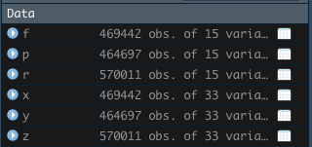
Packages required for this analysis are:-
For Plotting Graphs
ggplot2
For Geomapping
RgoogleMaps
ggmap
mapproj
sf
dplyr
OpenStreetMap
devtools
Variables that stores the data:-

Slide 7
Structure of Original Raw Data:-
Same for all the datasets.
Number of rows or records is different.
Number of Columns = 33 for all.
Basic structure:-
> str(z)
'data.frame': 570011 obs. of 33 variables:
$ Accident_Index : Factor w/ 366193 levels "2.01E+07","2.01E+08",..: 240 241 242 243 244 245 246 247 248 249 ...
$ Location_Easting_OSGR : int 525680 524170 524520 526900 528060 524770 524220 525890 527350 524550 ...
$ Location_Northing_OSGR : int 178240 181650 182240 177530 179040 181160 180830 179710 177650 180810 …
$ Longitude : num -0.191 -0.212 -0.206 -0.174 -0.157 ...
$ Latitude : num 51.5 51.5 51.5 51.5 51.5 ...
$ Police_Force : int 1 1 1 1 1 1 1 1 1 1 ...
$ Accident_Severity : int 2 3 3 3 3 3 3 3 3 3 ...
$ Number_of_Vehicles : int 1 1 2 1 1 2 2 1 2 2 ...
$ Number_of_Casualties : int 1 1 1 1 1 1 1 2 2 5 ...
$ Date : Factor w/ 1095 levels "01/01/2005","01/01/2006",..: 109 145 181 217 325 361 433 469 505 505 ...
$ Day_of_Week : int 3 4 5 6 2 3 5 6 7 7 ...

Slide 8
$ Time : Factor w/ 1440 levels "","00:01","00:02",..: 1063 1057 16 636 1274 761 1241 1056 1364 961 ...
$ Local_Authority_.District. : int 12 12 12 12 12 12 12 12 12 12 ...
$ Local_Authority_.Highway. : Factor w/ 207 levels "E06000001","E06000002",..: 112 112 112 112 112 112 112 112 112 112 ...
$ X1st_Road_Class : int 3 4 5 3 6 6 5 3 3 4 ...
$ X1st_Road_Number : int 3218 450 0 3220 0 0 0 315 3212 450 ...
$ Road_Type : Factor w/ 6 levels "Dual carriageway",..: 4 1 4 4 4 4 4 1 4 4 ...
$ Speed_limit : int 30 30 30 30 30 30 30 30 30 30 ...
$ Junction_Detail : logi NA NA NA NA NA NA ...
$ Junction_Control : Factor w/ 5 levels "","Authorised person",..: 1 3 1 1 1 1 4 1 3 4 ...
$ X2nd_Road_Class : int -1 5 -1 -1 -1 -1 6 -1 4 5 ...
$ X2nd_Road_Number : int 0 0 0 0 0 0 0 0 304 0 ...
$ Pedestrian_Crossing.Human_Control : Factor w/ 4 levels "","Control by other authorised person",..: 4 4 4 4 4 4 4 4 4 4 ...
$ Pedestrian_Crossing.Physical_Facilities : Factor w/ 7 levels "","Central refuge",..: 7 6 4 4 4 4 4 4 6 2 ...
$ Light_Conditions : Factor w/ 5 levels "Darkeness: No street lighting",..: 5 3 3 5 2 5 3 5 3 5 ...
$ Weather_Conditions : Factor w/ 10 levels "","Fine with high winds",..: 7 3 3 3 3 7 3 3 3 3 ...
$ Road_Surface_Conditions : Factor w/ 6 levels "","Dry","Flood (Over 3cm of water)",..: 6 2 2 2 6 6 2 2 2 2 ...
$ Special_Conditions_at_Site : Factor w/ 9 levels "","Auto traffic signal partly defective",..: 5 5 5 5 5 6 5 5 5 5 ...
$ Carriageway_Hazards : Factor w/ 7 levels "","Any animal (except a ridden horse)",..: 5 5 5 5 5 5 5 5 5 5 ...
$ Urban_or_Rural_Area : int 1 1 1 1 1 1 1 1 1 1 ...
$ Did_Police_Officer_Attend_Scene_of_Accident: Factor w/ 3 levels "","No","Yes": 3 3 3 3 3 3 3 3 3 3 ...
$ LSOA_of_Accident_Location : Factor w/ 33774 levels "","E01000001",..: 2782 2842 2790 2773 2796 2765 2808 2822 2833 2808 ...
$ Year : int 2005 2005 2005 2005 2005 2005 2005 2005 2005 2005 ...

Slide 9
Structure of Filtered Data Frame:-
Same for all .
Number of rows or records is different.
Number of columns = 15 for all.
Filtered Structure:-
> str(f)
'data.frame': 469442 obs. of 15 variables:
$ Accident_Index : Factor w/ 297707 levels "2.00903E+12",..: 275 276 277 278 279 280 281 282 283 284 ...
$ Longitude : num -0.201 -0.199 -0.18 -0.203 -0.173 ...
$ Latitude : num 51.5 51.5 51.5 51.5 51.5 ...
$ Number_of_Vehicles : int 2 2 2 2 2 2 2 1 1 1 ...
$ Number_of_Casualties : int 1 11 1 1 1 3 1 1 2 1 ...
$ Date : Factor w/ 1095 levels "01/01/2009","01/01/2010",..: 1 145 109 145 181 1 253 37 217 325 ...
$ Day_of_Week : Factor w/ 7 levels "1","2","3","4",..: 5 2 1 2 3 5 5 6 4 7 ...
$ Time : Factor w/ 1440 levels "","00:01","00:02",..: 912 660 860 491 1046 709 839 799 736 593 ...
$ Speed_limit : Factor w/ 8 levels "10","15","20",..: 4 4 4 4 4 4 4 4 4 4 ...
$ Light_Conditions : Factor w/ 5 levels "Darkeness: No street lighting",..: 5 5 5 5 3 5 5 5 5 5 ...
$ Weather_Conditions : Factor w/ 10 levels "","Fine with high winds",..: 3 3 3 5 3 3 3 3 3 5 ...
$ Road_Surface_Conditions : Factor w/ 6 levels "","Dry","Flood (Over 3cm of water)",..: 2 6 2 4 2 2 2 2 2 6 ...
$ Urban_or_Rural_Area : Factor w/ 2 levels "1","2": 1 1 1 1 1 1 1 1 1 1 ...
$ Did_Police_Officer_Attend_Scene_of_Accident: Factor w/ 3 levels "","No","Yes": 3 3 3 3 3 3 3 3 3 3 ...
$ Year : int 2009 2009 2009 2009 2009 2009 2009 2009 2009 2009 ...

Slide 10
FILE-1
Number of Accidents in 2005:-
> a=f[f$Year==2005,]
> nrow(a)
[1] 198735
Number of Accidents in 2006:-
> b=f[f$Year==2006,]
> nrow(b)
[1] 189161
Number of Accidents in 2007:-
> c=f[f$Year==2007,]
> nrow(c)
[1] 182115

Slide 11
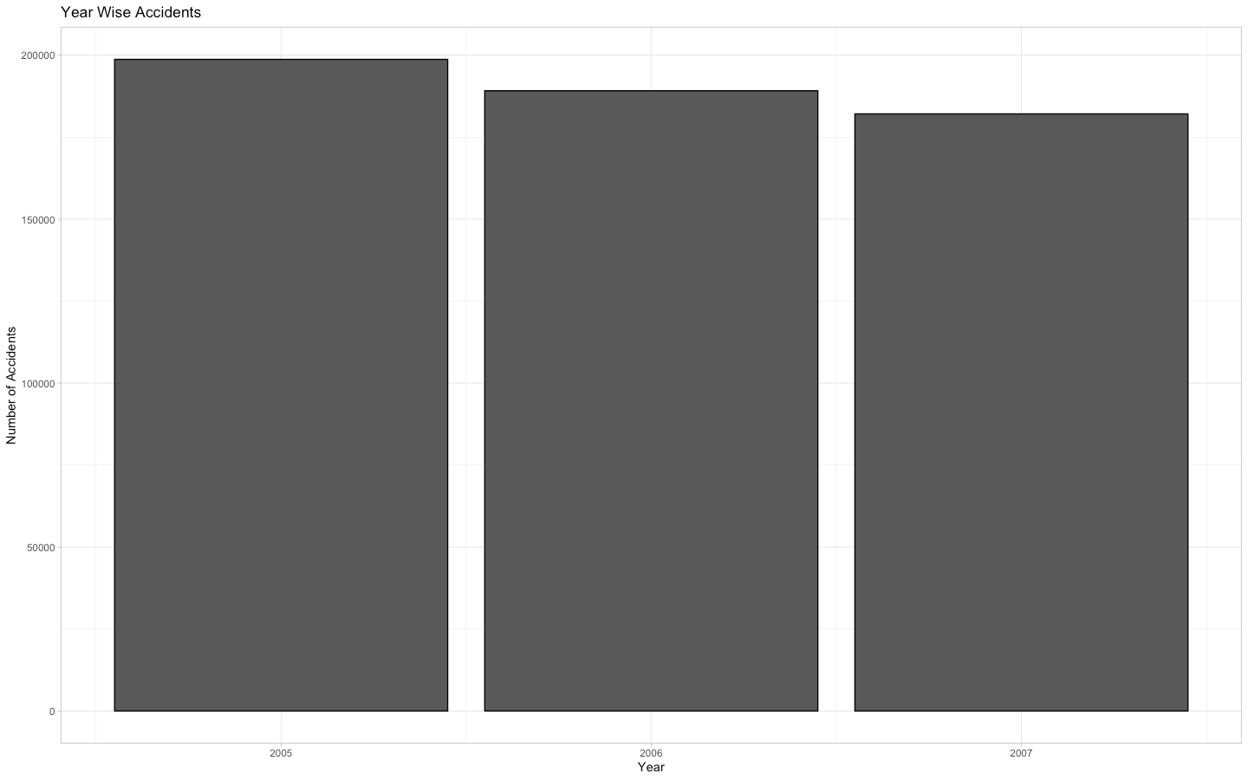
Number of accidents per year.
Code-
>ggplot(r, aes(Year, fill=Year))+geom_bar(color="black")+labs(x="Year", y="Number of Accidents", title="Year Wise Accidents")+theme_light()

Slide 12
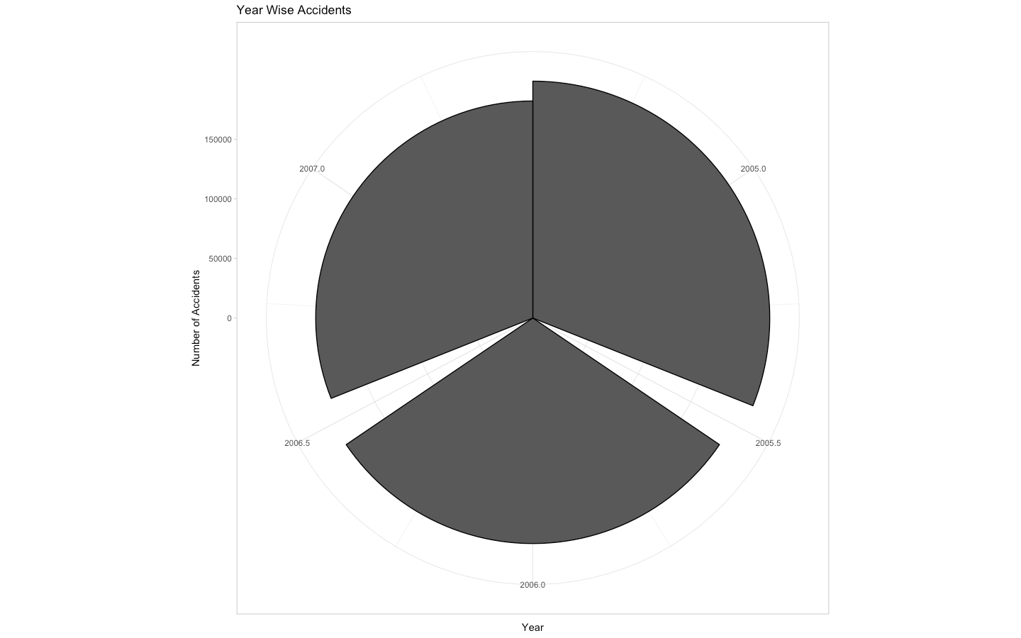
Pie-chart representation of the same.
CODE:-
> ggplot(r, aes(Day_of_Week, fill=Day_of_Week))+geom_bar(color="black")+labs(x="Day", y="Number of Accidents", title="WeekDay Wise Accidents")+theme_dark()+coord_polar("x")

Slide 13
Number of Vehicles Involved in the accident?
Mean Number of Vehicles:-
Code:-
> mean(r$Number_of_Vehicles)
[1] 1.840773
Median of Number of vehicles
Code:-
>v=sort(r$Number_of_Vehicles)
> median(v)
[1] 2
Mode for Number of Vehicles
Code:-
> a=table(r$Number_of_Vehicles)
> a
1 2 3 4 5 6 7 8 9 10 11 12 13 14 15 16 17 18 20 22
171697 336662 48029 10154 2290 706 251 113 52 21 9 7 3 5 3 2 1 2 2 1
28
1
> max(a)
[1] 336662 #for 2
Therefore 2 is mode for number of vehicles.
InterQuartile Range
Code:-
> IQR(r$Number_of_Vehicles)
[1] 1
Maximum number of vehicles
Code:-
> max(r$Number_of_Vehicles)
[1] 28

Slide 14
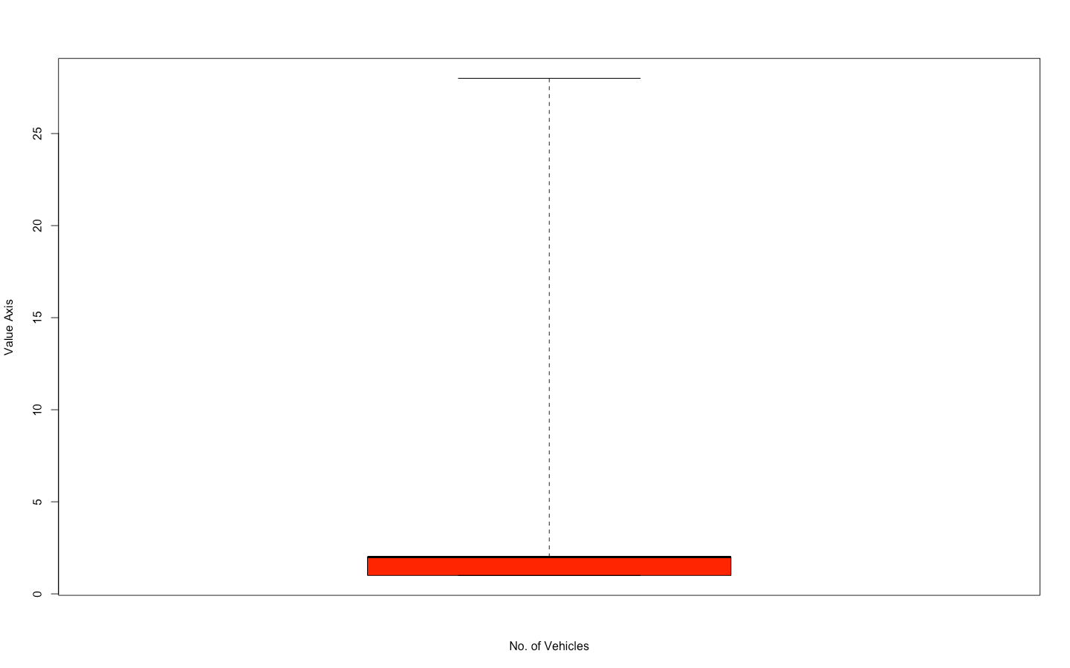
Main Code For the boxplot:-
> boxplot(r$Number_of_Vehicles, col="Red", range=0, ylab="Value Axis", xlab="No. of Vehicles")
Explanation:-
The red zone shows the interquartile range .
the the upper bold black line shows the median i.e. 2
Others are the outliers in the graph shown by the dotted line because number of vehicles (1 and 2) are in abundance.
The maximum value is shown by the topmost horizontal line i.e. 28.

Slide 15
Number of Casualties in the accidents?
Mean Number of Casualties:-
Code:-
> mean(r$Number_of_Casualties)
[1] 1.363484
Median for Number of Casualties
Code:-
>t=sort(r$Number_of_Casualties)
> median(t)
[1] 1
Mode for Number of Vehicles
Code:-
> b=table(r$Number_of_Casualties)
> b
1 2 3 4 5 6 7 8 9 10 11 12 13 14 15 16 17 18 19 20
432213 95218 26860 9718 3685 1382 459 201 98 45 33 11 17 10 9 7 6 4 5 3
21 22 23 25 26 28 29 35 36 40 41 42 45 68
1 7 3 1 3 1 4 1 1 1 1 1 1 1
> max(b)
[1] 432213 #for 1
Inter Quartile Range
Code:-
> IQR(r$Number_of_Casualties)
[1] 0
Maximum number of Casualties
Code:-
> max(r$Number_of_Casualties)
[1] 68

Slide 16
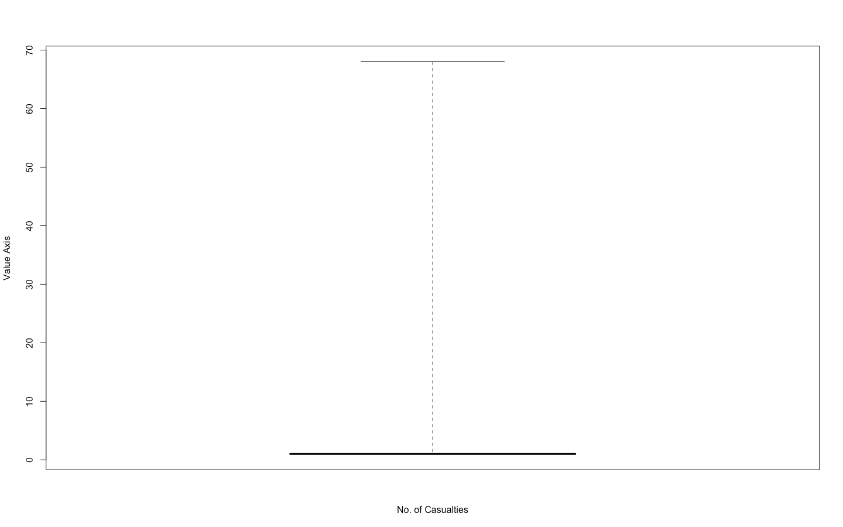
Code and graph:-
boxplot(r$Number_of_Casualties, col="Yellow", range=0, ylab="Value Axis", xlab="No. of Casualties")
Explanation:-
The Yellow zone shows the interquartile range i.e 0
the the upper bold black line shows the median i.e. 1
Others are the outliers in the graph shown by the dotted line
The maximum value is shown by the topmost horizontal line i.e. 68.

Slide 17
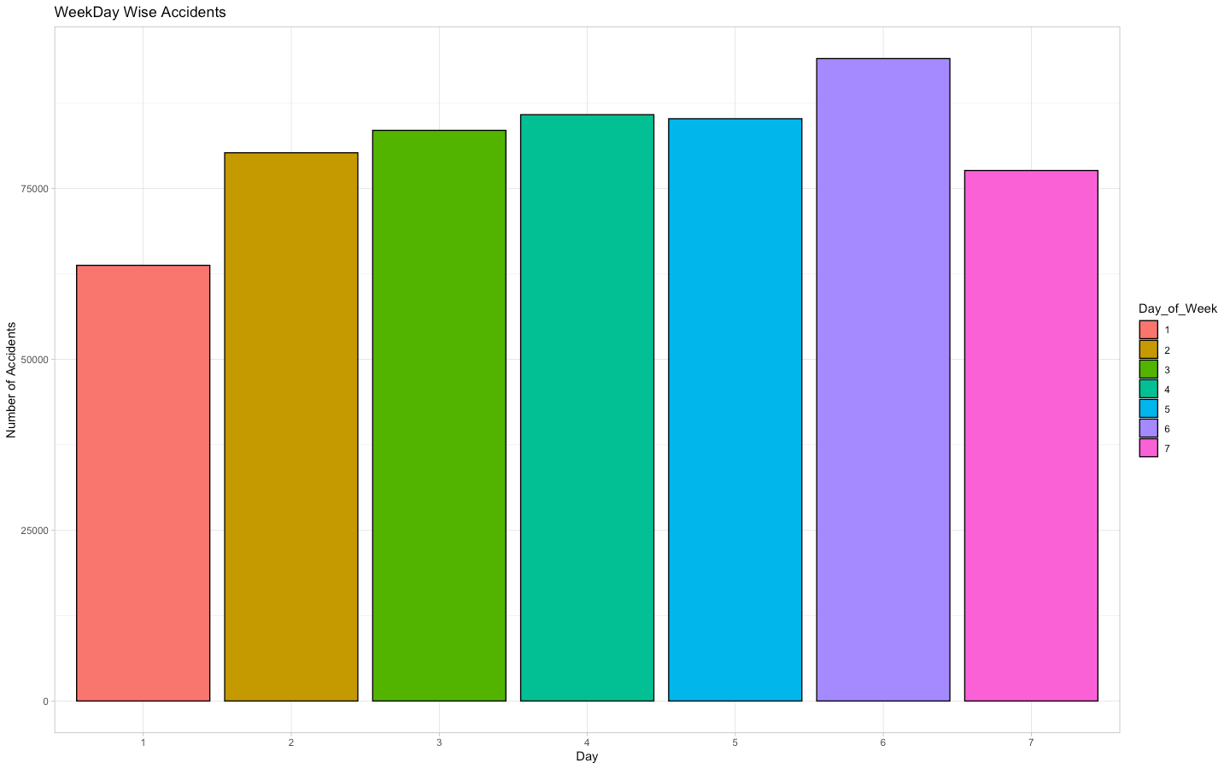
NUMBER OF ACCIDENTS PER DAY
Code:- (FOR THE BAR CHART OF THE SAME.)
> ggplot(r, aes(Day_of_Week, fill=Day_of_Week))+geom_bar(color="black")+labs(x="Day", y="Number of Accidents", title="WeekDay Wise Accidents")+theme_light()
First instinct from the graph is
Most of the accidents occur on Saturday.
Reason can be drink and drive.

Slide 18
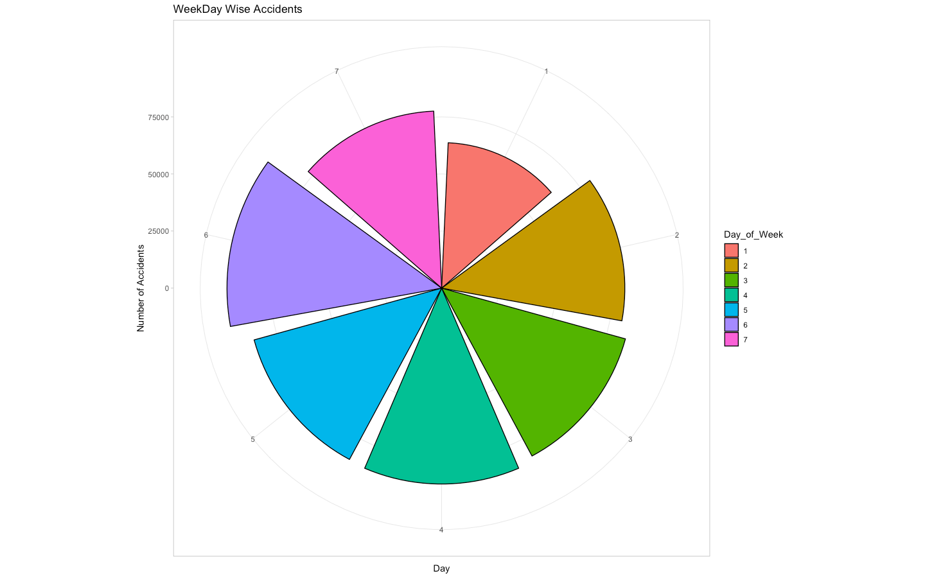
PIE-CHART FOR THE SAME.
-
CODE:-
ggplot(r, aes(Day_of_Week, fill=Day_of_Week))+geom_bar(color="black")+labs(x="Day", y="Number of Accidents", title="WeekDay Wise Accidents")+theme_light()+coord_polar("x")

Slide 19
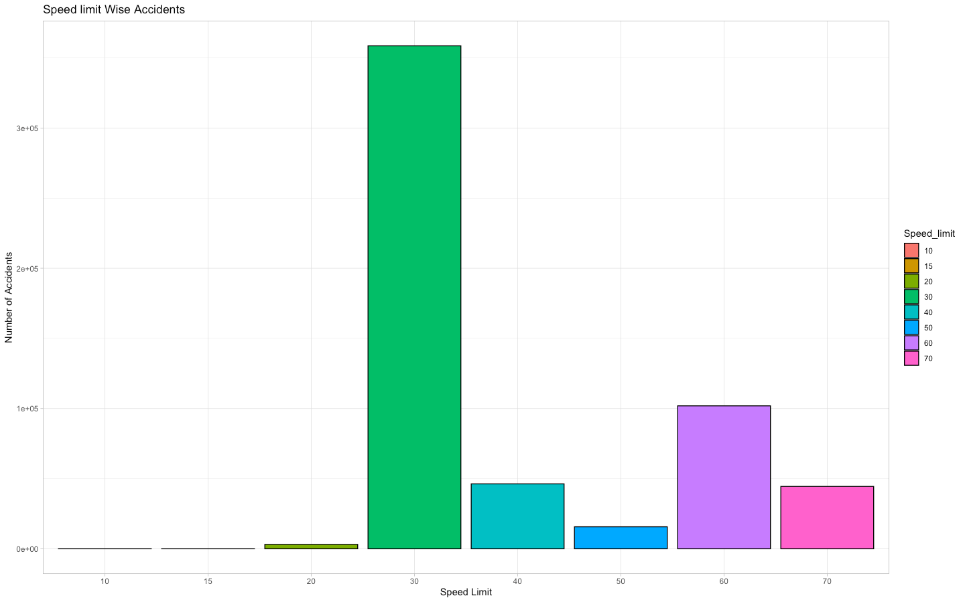
Accidents on the basis of speed limit
Code:-
> ggplot(r, aes(Speed_limit, fill=Speed_limit))+geom_bar(color="black")+labs(x="Speed Limit", y="Number of Accidents", title="Speed limit Wise Accidents")+theme_light()
Explanaton:-
It’s quite ironical that roads with higher speed limit have less accidents.
Most of the accidents happen on the roads with speed limit 30mph.
It might be because such roads are congested and narrow so they will also have more traffic density.

Slide 20
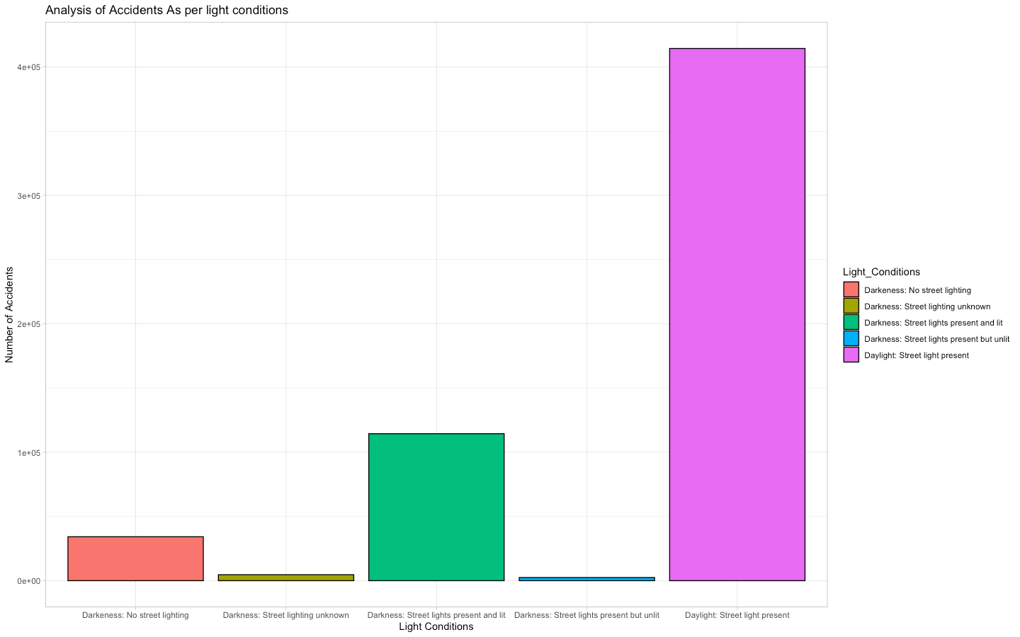
Accidents analysis according to Light Conditions:-
graph:-
> ggplot(r, aes(Light_Conditions, fill=Light_Conditions))+geom_bar(color="black")+labs(x="Light Conditions", y="Number of Accidents", title="Analysis of Accidents As per light conditions")+theme_light()

Slide 21
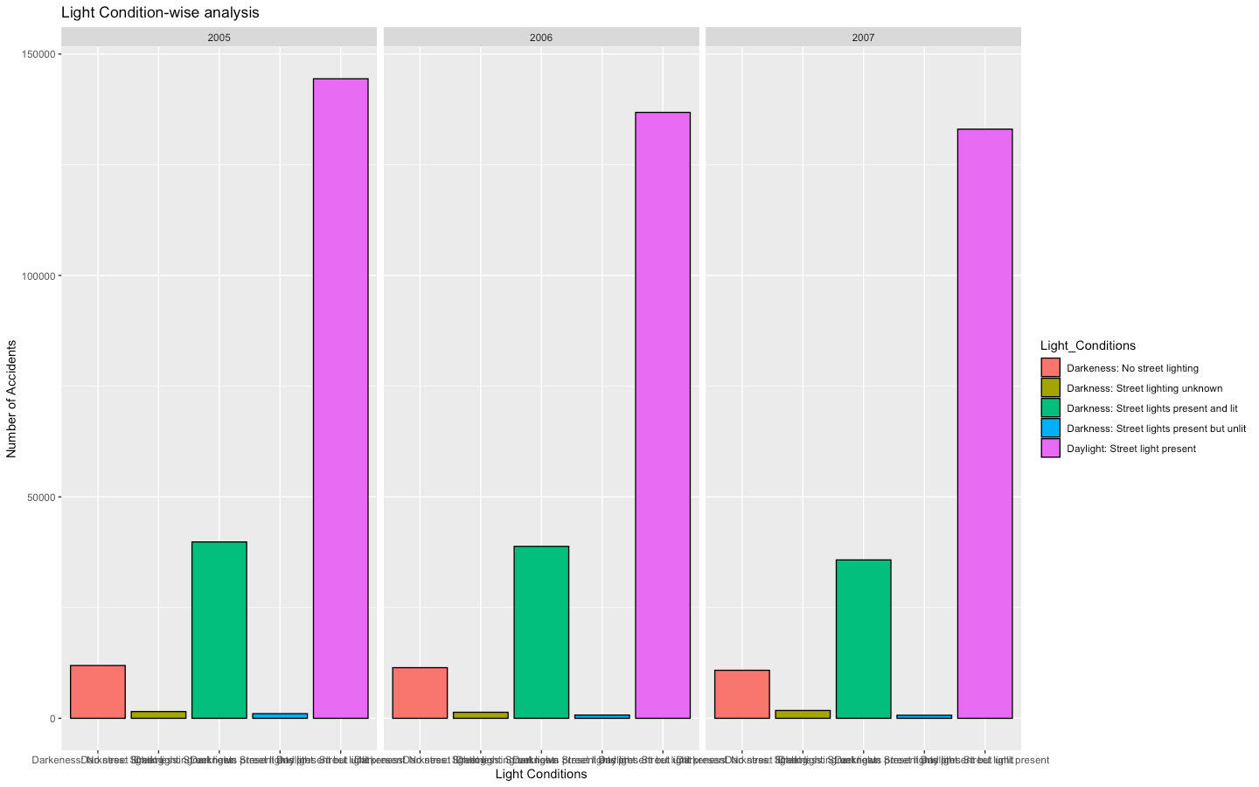
Facet wrap for the same
Explanation:-
This is also very ironical since most of the accidents occured in the daylight.
Street Lights are also present.
Least took place in the dark on the roads with unlit street lights.
These conclusions are same for all the three years.
Code:-
> ggplot(r, aes(Light_Conditions, fill=Light_Conditions))+geom_bar(color="black")+labs(x="Light Conditions", y="Number of Accidents", title="Light Condition-wise analysis")+facet_wrap(r$Year)

Slide 22
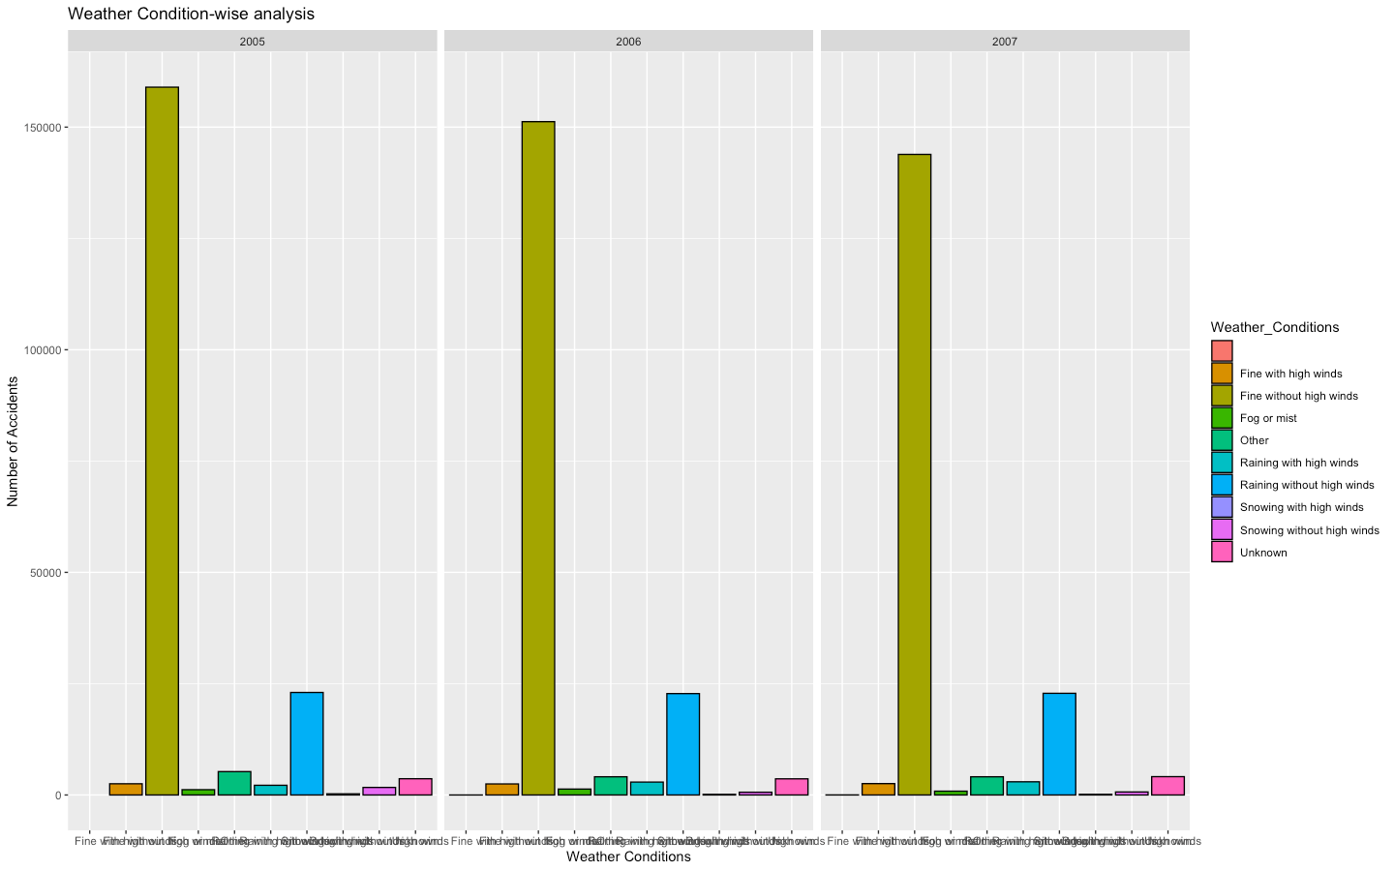
Accidents according to Weather conditions:-
> ggplot(r, aes(Weather_Conditions, fill=Weather_Conditions))+geom_bar(color="black")+labs(x="Weather Conditions", y="Number of Accidents", title="Weather Condition-wise analysis")+facet_wrap(r$Year)

Slide 23
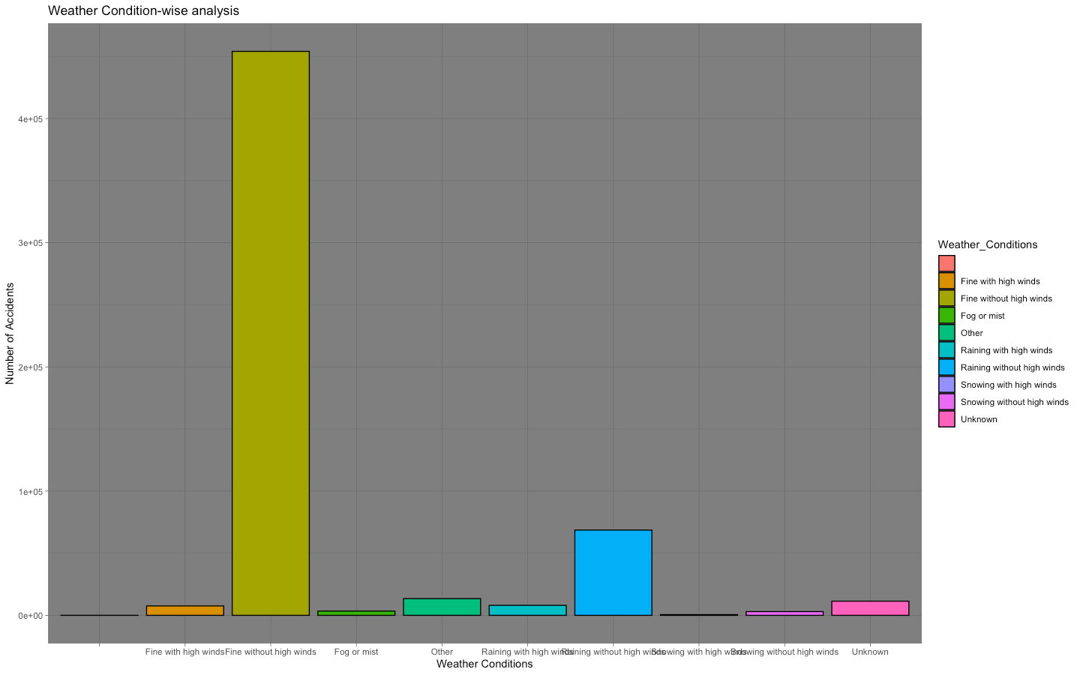
BAR GARPH FOR THE SAME
ggplot(r, aes(Weather_Conditions, fill=Weather_Conditions))+geom_bar(color="black")+labs(x="Weather Conditions", y="Number of Accidents", title="Weather Condition-wise analysis")+theme_dark()
Explanation:-
Most of the accidents happened in the fine weather with no winds which is also ironic.
And almost no accidents in the snow with high winds.

Slide 24
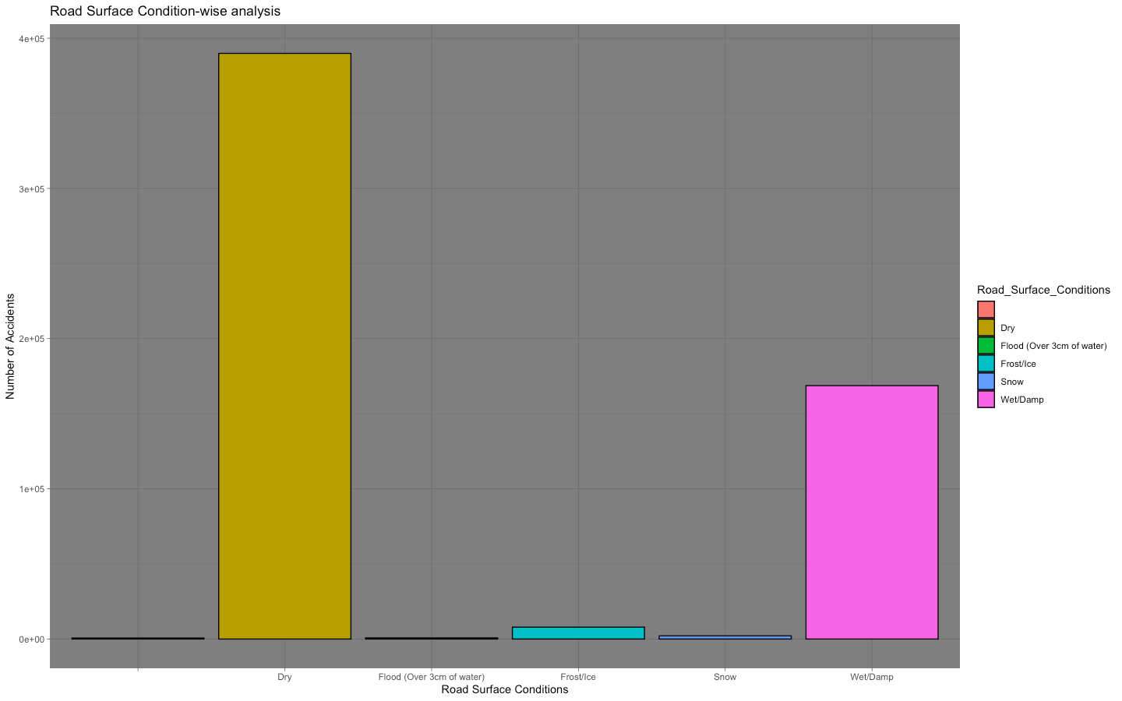
Accidents according to the Road Surface Conditions:-
> ggplot(r, aes(Road_Surface_Conditions, fill=Road_Surface_Conditions))+geom_bar(color="black")+labs(x="Road Surface Conditions", y="Number of Accidents", title="Road Surface Condition-wise analysis")+theme_dark()

Slide 25
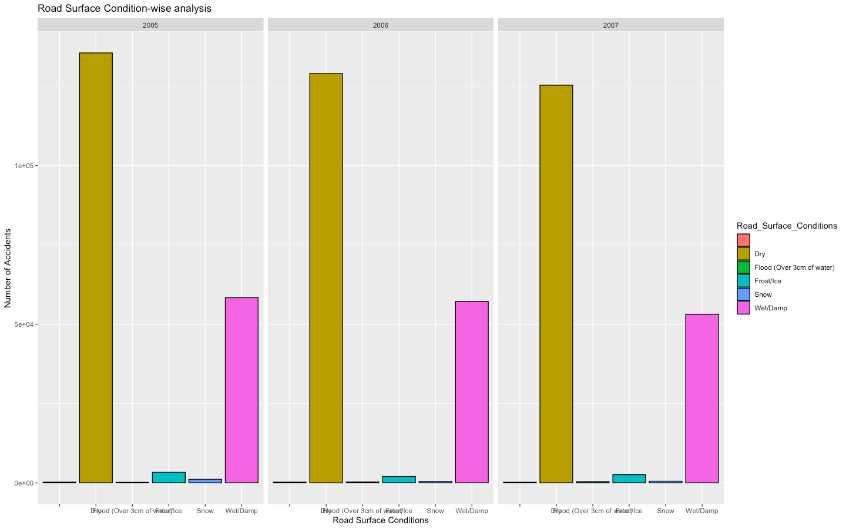
ggplot(r, aes(Road_Surface_Conditions, fill=Road_Surface_Conditions))+geom_bar(color="black")+labs(x="Road Surface Conditions", y="Number of Accidents", title="Road Surface Condition-wise analysis")+facet_wrap(r$Year)
Explanation:-
Most of the accidents happened on the dry roads.
Least happened on the flooded roads with water over 3 c.m.

Slide 26
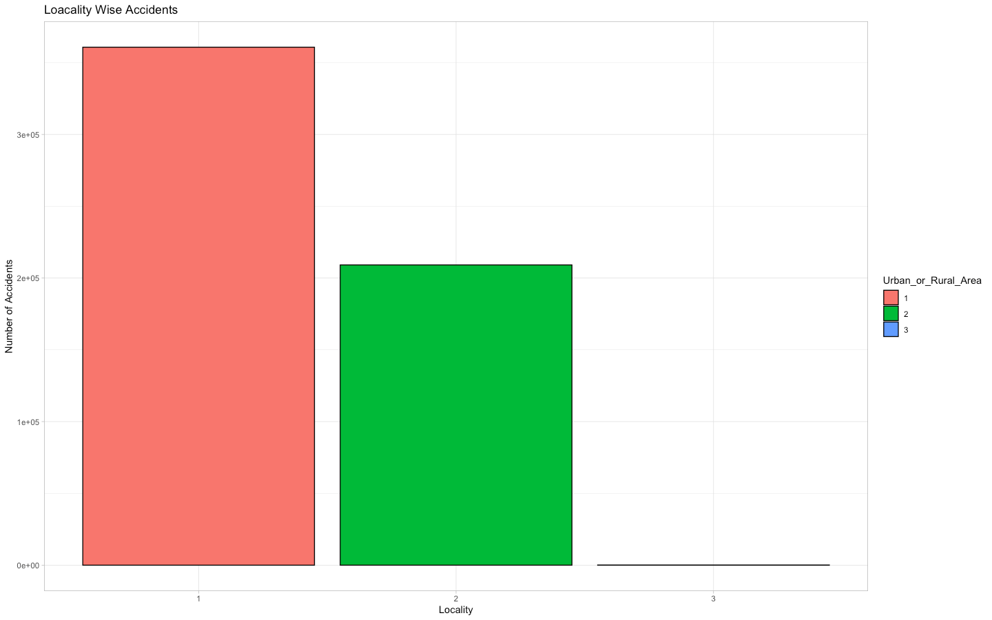
Location analysis of Accidents (In urban or Rural Locality):-
Explanation:-
More accidents occured in the Urban Locality as expected.
There were few such cases where the locality is not mentioned.
> ggplot(r, aes(Urban_or_Rural_Area, fill=Urban_or_Rural_Area))+geom_bar(color="black")+labs(x="Locality", y="Number of Accidents", title="Loacality Wise Accidents")+theme_light()

Slide 27
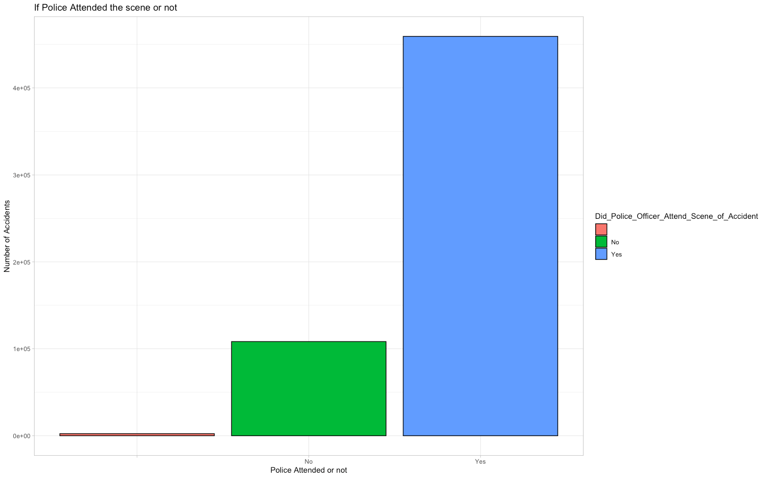
If the Police officer attended the scene or not:-
Explanation:-
In most of the cases, police officers attended the site
> ggplot(r, aes(Did_Police_Officer_Attend_Scene_of_Accident, fill=Did_Police_Officer_Attend_Scene_of_Accident))+geom_bar(color="black")+labs(x="Police Attended or not", y="Number of Accidents", title="If Police Attended the scene or not")+theme_light()

Slide 28
FILE-2
Number of Accidents in 200:-
> m=p[p$Year==2009, ]
> nrow(m)
[1] 163554
Number of Accidents in 2006:-
> n=p[p$Year==2010, ]
> nrow(n)
[1] 154414
Number of Accidents in 2007:-
> o=p[p$Year==2011, ]
> nrow(o)
[1] 151474

Slide 29
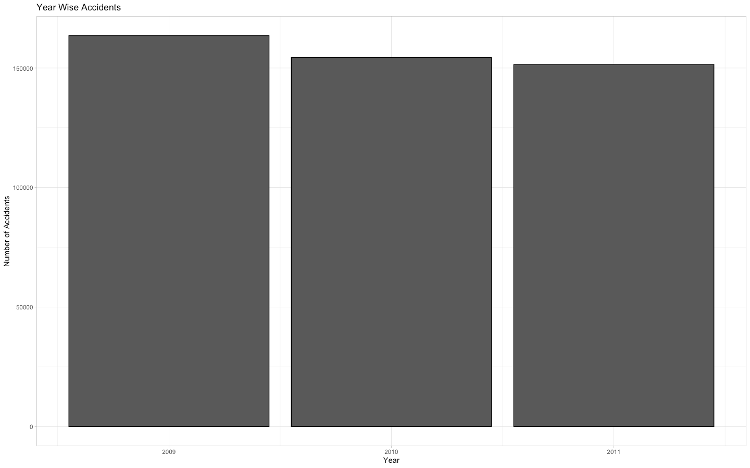
Number of Accidents per year
>ggplot(f, aes(Year, fill=Year))+geom_bar(color="black")+labs(x="Year", y="Number of Accidents", title="Year Wise Accidents")+theme_light()

Slide 30
Number of Vehicles Involved in the accident?
Mean Number of Vehicles:-
Code:-
> mean(f$Number_of_Vehicles)
[1] 1.823863
Median of Number of vehicles
Code:-
> median(f$Number_of_Vehicles)
[1] 2
Mode for Number of Vehicles
Code:-
> d=table(f$Number_of_Vehicles)
> d
1 2 3 4 5 6 7 8 9 10 11 12 13 14 15 16 17 18 19
143927 278806 36433 7691 1692 525 181 90 50 19 11 5 5 2 1 1 1 1 1
> max(d)
[1] 278806 #for 2
Therefore 2 is mode for number of vehicles.
Inter Quartile Range
Code:-
> IQR(f$Number_of_Vehicles)
[1] 1
Maximum number of vehicles
Code:-
> max(f$Number_of_Vehicles)
[1] 19

Slide 31
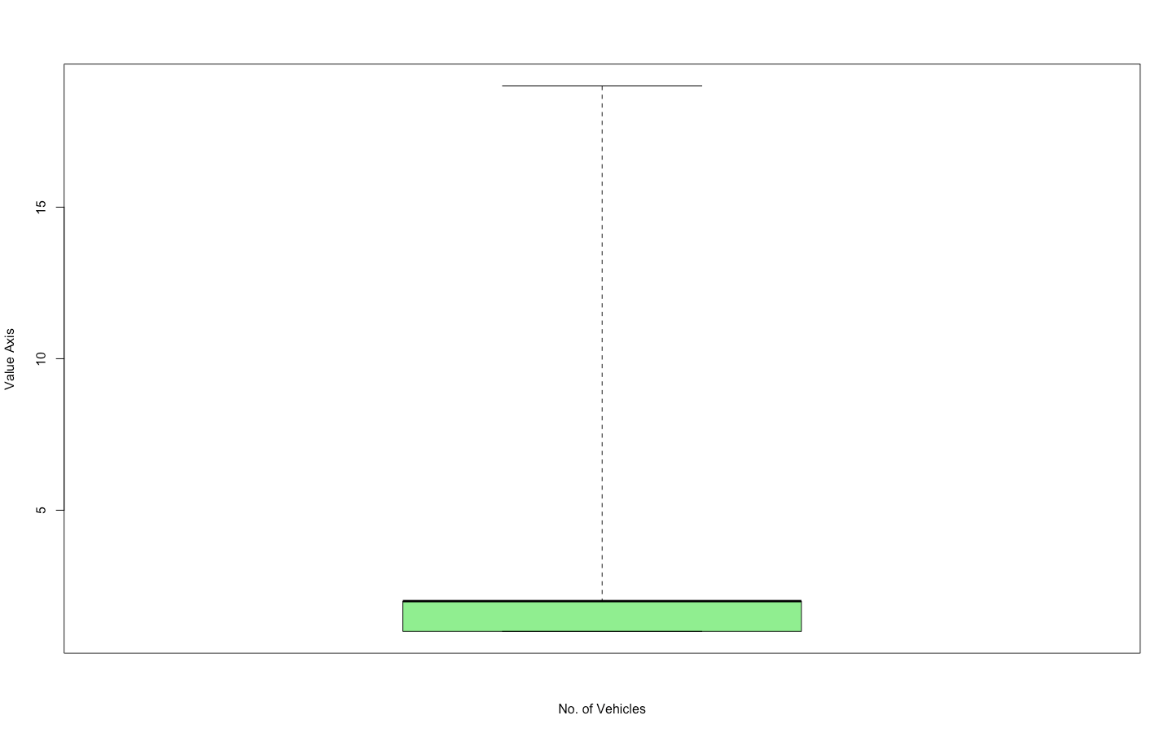
boxplot(f$Number_of_Vehicles, col="Red", range=0, ylab="Value Axis", xlab="No. of Vehicles")
Explanation:-
The Lightgreen zone shows the interquartile range i.e. 1
the the upper bold black line shows the median i.e. 2
Others are the outliers in the graph shown by the dotted line
The maximum value is shown by the topmost horizontal line i.e. 19.

Slide 32
Number of Casualties in the accidents?
Mean Number of Vehicles:-
Code:-
> mean(f$Number_of_Casualties)
[1] 1.351637
Median of Number of vehicles
Code:-
> median(f$Number_of_Casualties)
[1] 1
Mode for Number of Vehicles
Code:-
> e=table(f$Number_of_Casualties)
> e
1 2 3 4 5 6 7 8 9 10 11 12 13 14 15 16 17 18 19 20
360017 75128 21619 8008 2840 1079 369 153 67 46 28 20 14 10 4 4 5 6 1 4
21 22 23 24 25 26 27 28 29 30 31 32 33
3 2 1 3 1 1 1 1 2 1 2 1 1
> max(e)
[1] 360017 #for 1
Inter Quartile Range
Code:-
> IQR(f$Number_of_Casualties)
[1] 0
Maximum number of Casualties
Code:-
> max(f$Number_of_Casualties)
[1] 33

Slide 33
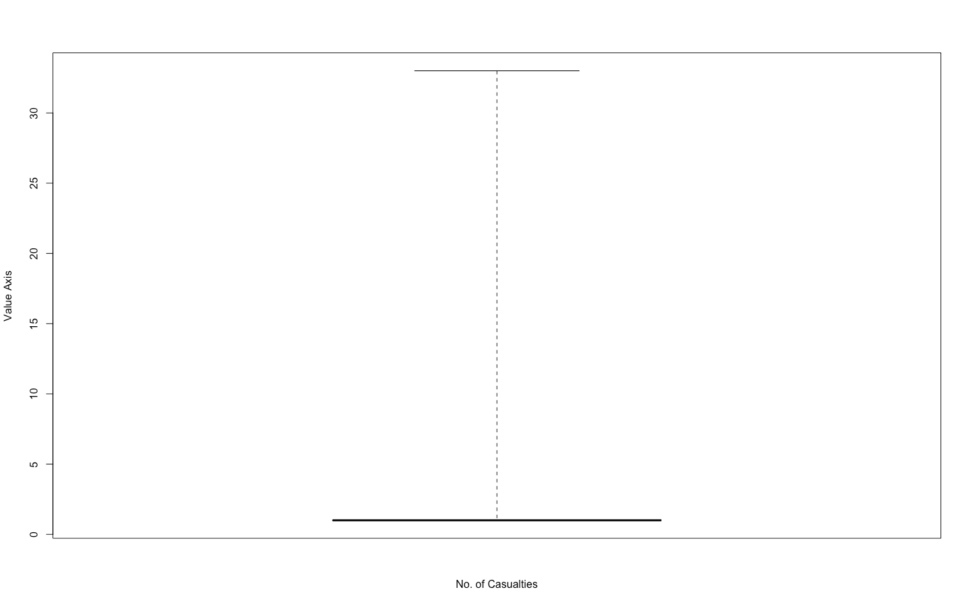
Main Code For the boxplot:-
> boxplot(f$Number_of_Casualties, col="Yellow", range=0, ylab="Value Axis", xlab="No. of Casualties")

Slide 34
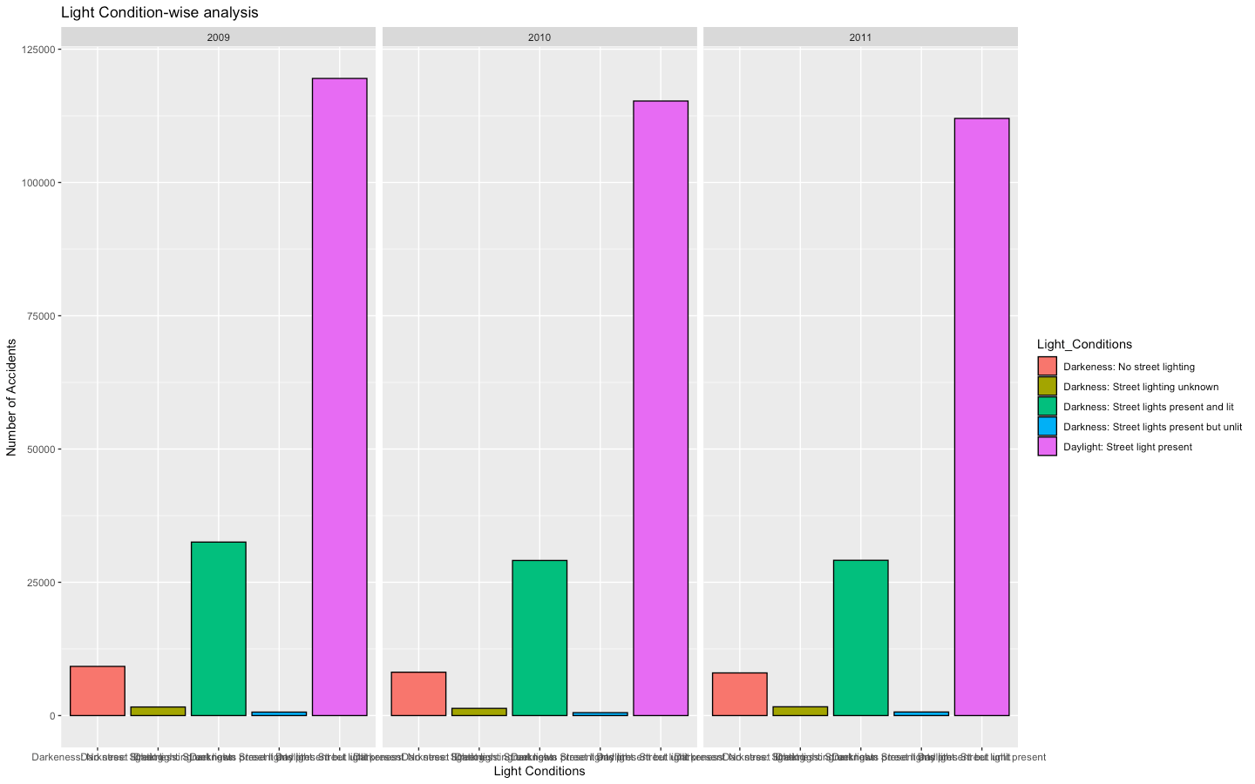
Accidents analysis according to Light Conditions:-
> ggplot(f, aes(Light_Conditions, fill=Light_Conditions))+geom_bar(color="black")+labs(x="Light Conditions", y="Number of Accidents", title="Light Condition-wise analysis")+facet_wrap(f$Year)

Slide 35
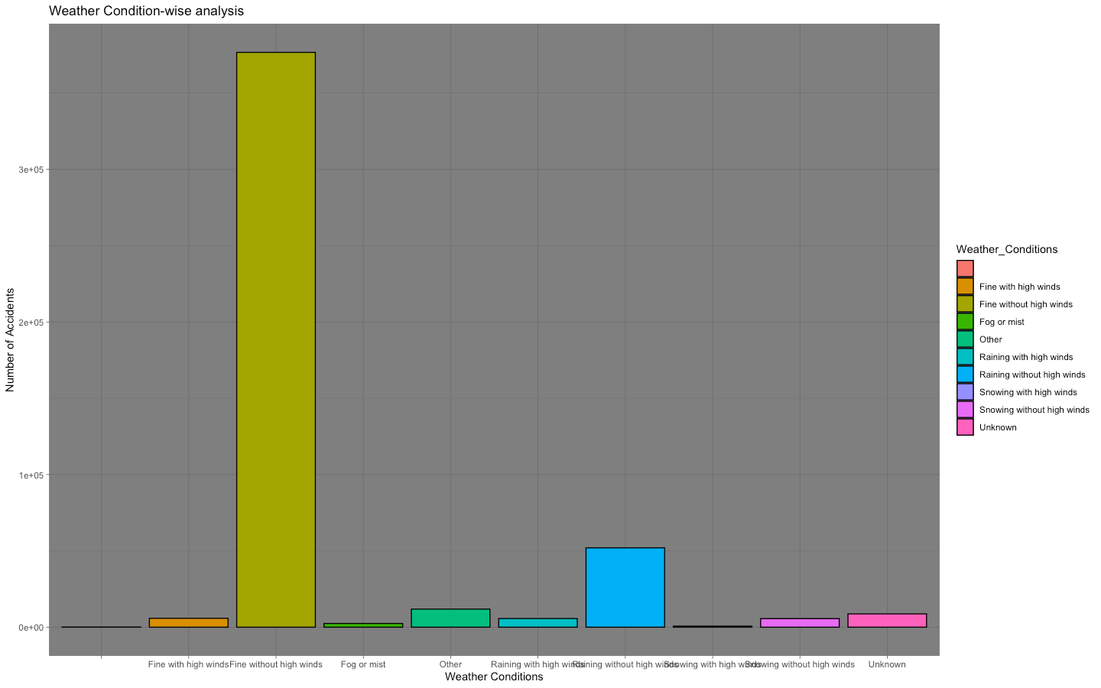
Accidents according to Weather conditions:-
ggplot(f, aes(Weather_Conditions, fill=Weather_Conditions))+geom_bar(color="black")+labs(x="Weather Conditions", y="Number of Accidents", title="Weather Condition-wise analysis")+theme_dark()

Slide 36
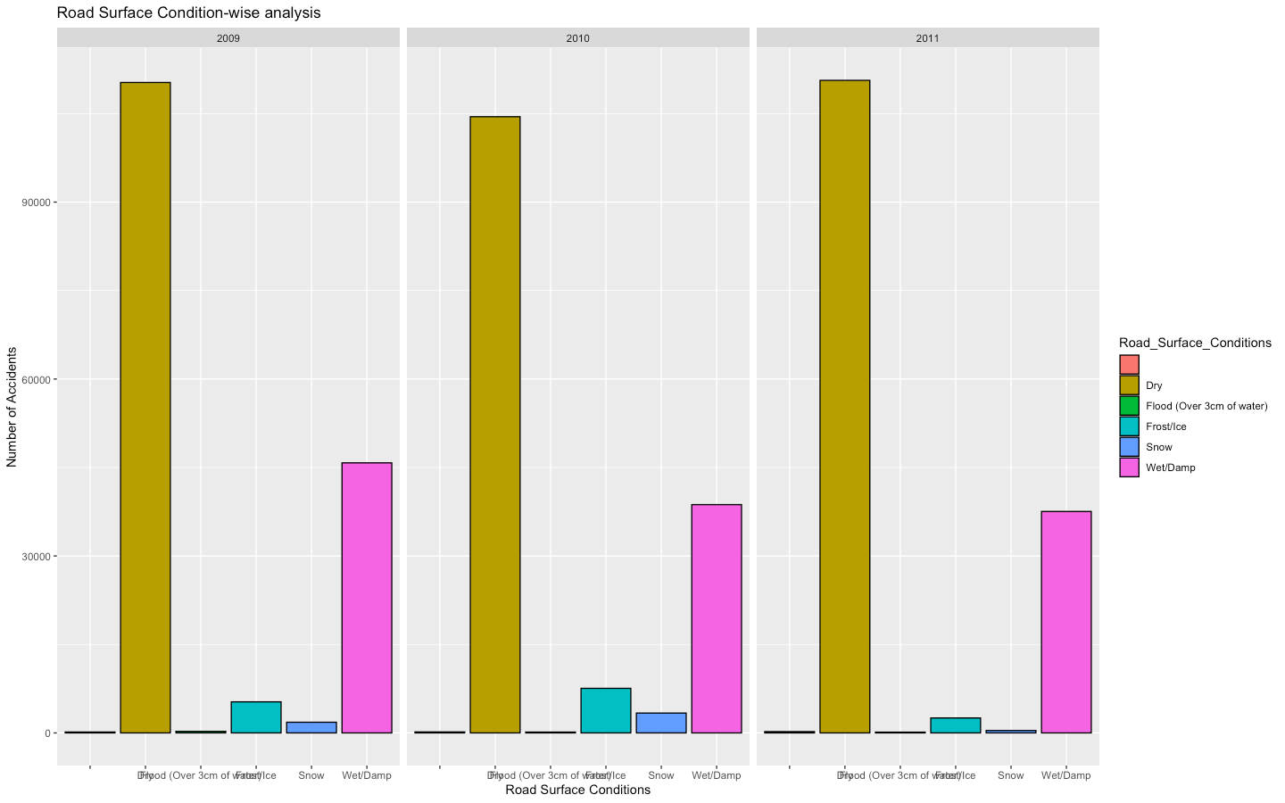
Accidents according to the Road Surface Conditions:-
> ggplot(f, aes(Road_Surface_Conditions, fill=Road_Surface_Conditions))+geom_bar(color="black")+labs(x="Road Surface Conditions", y="Number of Accidents", title="Road Surface Condition-wise analysis")+facet_wrap(f$Year)

Slide 37
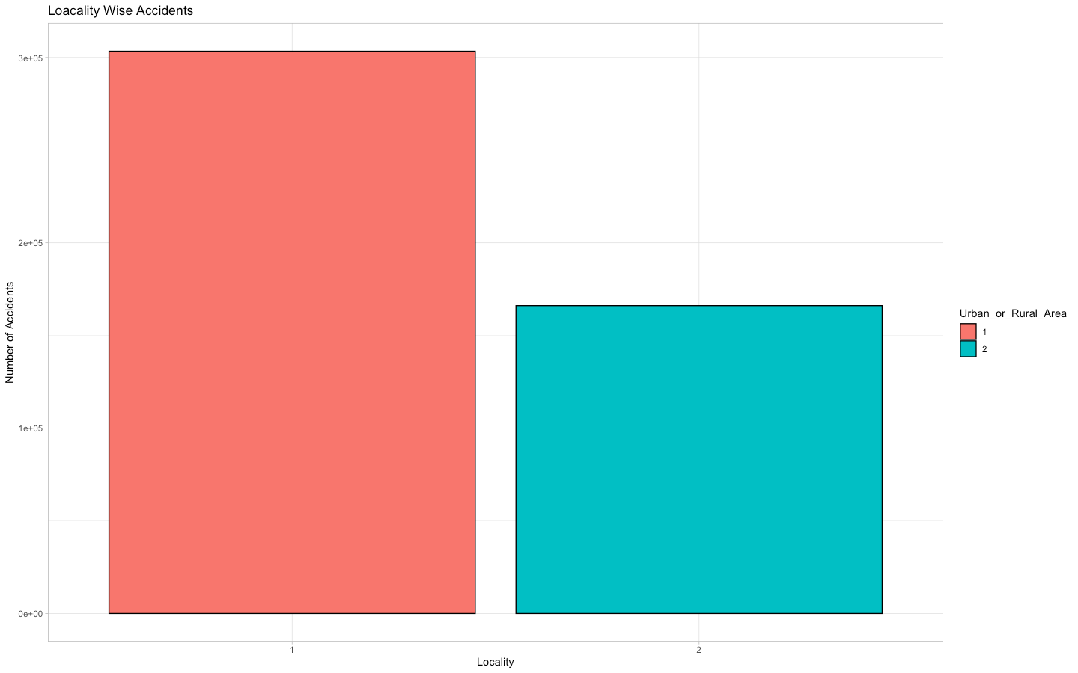
Location analysis of Accidents (In urban or Rural Locality):-
ggplot(f, aes(Urban_or_Rural_Area, fill=Urban_or_Rural_Area))+geom_bar(color="black")+labs(x="Locality", y="Number of Accidents", title="Loacality Wise Accidents")+theme_light()

Slide 38

If the Police officer attended the scene or not:-
ggplot(f, aes(Did_Police_Officer_Attend_Scene_of_Accident, fill=Did_Police_Officer_Attend_Scene_of_Accident))+geom_bar(color="black")+labs(x="Police Attended or not", y="Number of Accidents", title="If Police Attended the scene or not")+theme_light()

Slide 39
FILE-3
Number of Accidents in 2009:-
> t=p[p$Year==2012, ]
> nrow(t)
[1] 179715
Number of Accidents in 2010:-
> u=p[p$Year==2013, ]
> nrow(u)
[1] 138660
Number of Accidents in 2011:-
> v=p[p$Year==2014, ]
> nrow(v)
[1] 146322

Slide 40
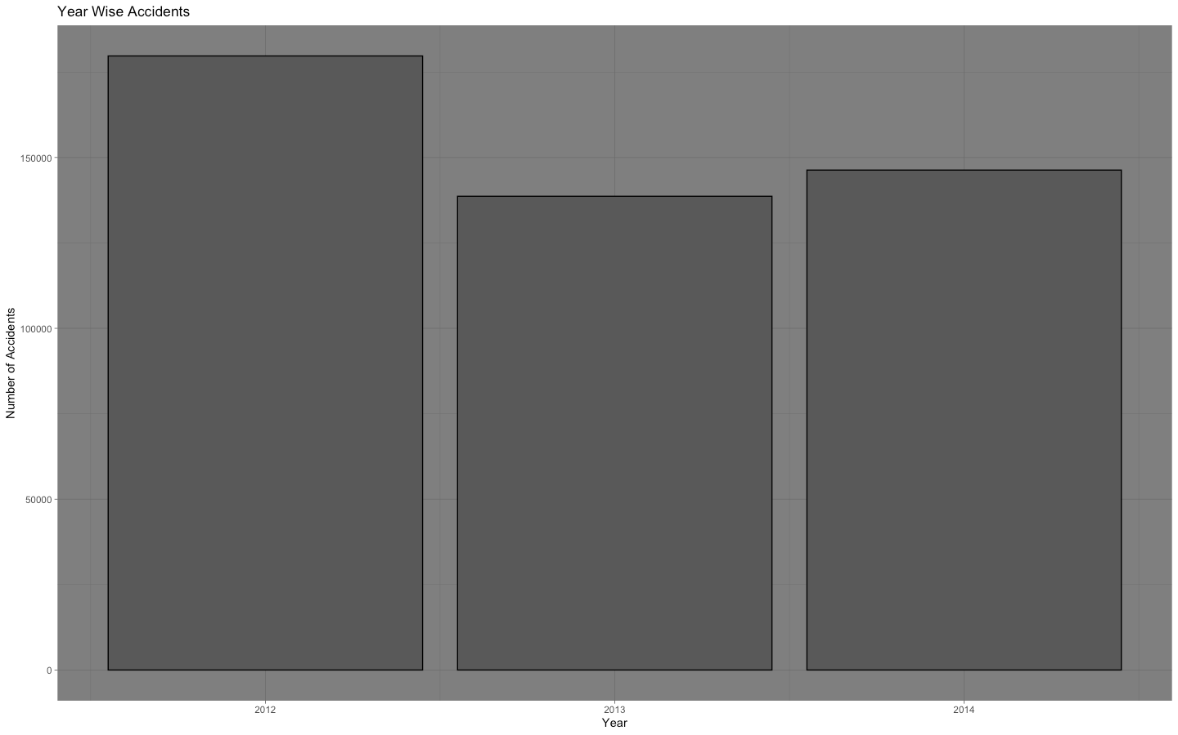
Number of Accidents per year
>ggplot(r, aes(Year, fill=Year))+geom_bar(color="black")+labs(x="Year", y="Number of Accidents", title="Year Wise Accidents")+theme_light()

Slide 41
Number of Vehicles Involved in the accident?
Mean Number of Vehicles:-
Code:-
> mean(r$Number_of_Vehicles)
[1] 146322
Median of Number of vehicles
Code:-
> median(r$Number_of_Vehicles)
[1] 2
Mode for Number of Vehicles
Code:-
> k=table(r$Number_of_Vehicles)
> k
1 2 3 4 5 6 7 8 9 10 11 12 13 14 15 16 17 18 20 22
171697 336662 48029 10154 2290 706 251 113 52 21 9 7 3 5 3 2 1 2 2 1
28
1
> max(k)
[1] 336662 #for 2
Therefore 2 is mode for number of vehicles.
Inter Quartile Range
Code:-
> IQR(f$Number_of_Vehicles)
[1] 1
Maximum number of vehicles
Code:-
> max(r$Number_of_Vehicles)
[1] 28

Slide 42
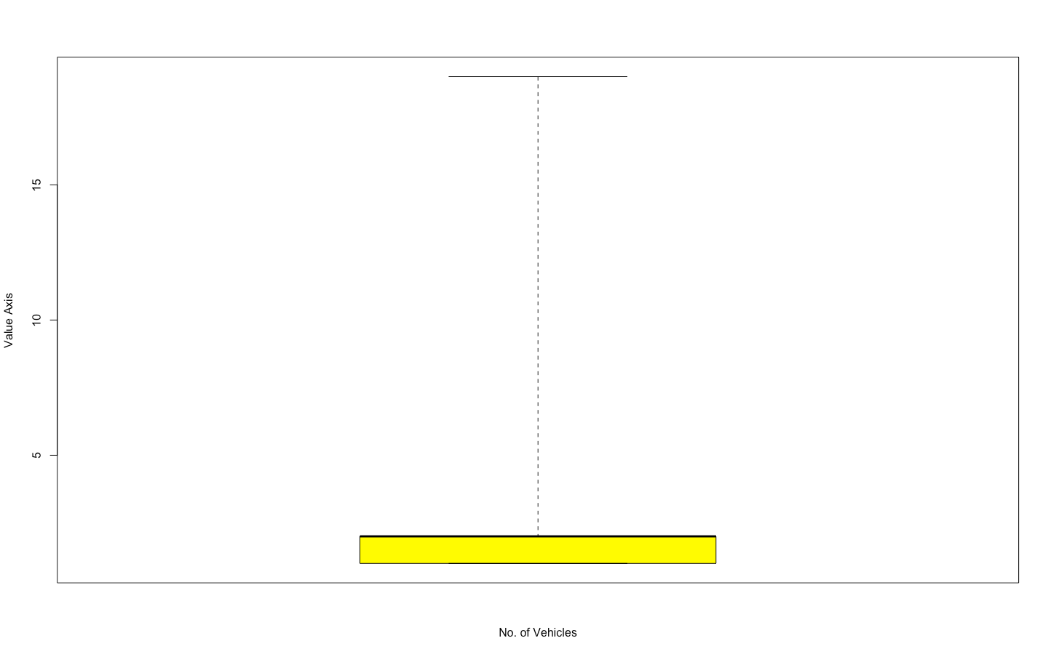
Main Code For the boxplot:-
> boxplot(r$Number_of_Vehicles, col="Red", range=0, ylab="Value Axis", xlab="No. of Vehicles")
Explanation:-
The Yellow zone shows the interquartile range i.e. 1
the the upper bold black line shows the median i.e. 2
Others are the outliers in the graph shown by the dotted line
The maximum value is shown by the topmost horizontal line i.e. 28.

Slide 43
Number of Casualties in the accidents?
Mean Number of Vehicles:-
Code:-
> mean(r$Number_of_Casualties)
[1] 1.363484
Median of Number of vehicles
Code:-
> median(r$Number_of_Casualties)
[1] 1
Mode for Number of Vehicles
Code:-
> s=table(r$Number_of_Casualties)
> s
1 2 3 4 5 6 7 8 9 10 11 12 13 14 15 16 17 18 19 20
432213 95218 26860 9718 3685 1382 459 201 98 45 33 11 17 10 9 7 6 4 5 3
21 22 23 25 26 28 29 35 36 40 41 42 45 68
1 7 3 1 3 1 4 1 1 1 1 1 1 1
> max(s)
[1] 432213 #for 1
Inter Quartile Range
Code:-
> IQR(r$Number_of_Casualties)
[1] 0
Maximum number of Casualties
Code:-
> max(r$Number_of_Casualties)
[1] 68

Slide 44
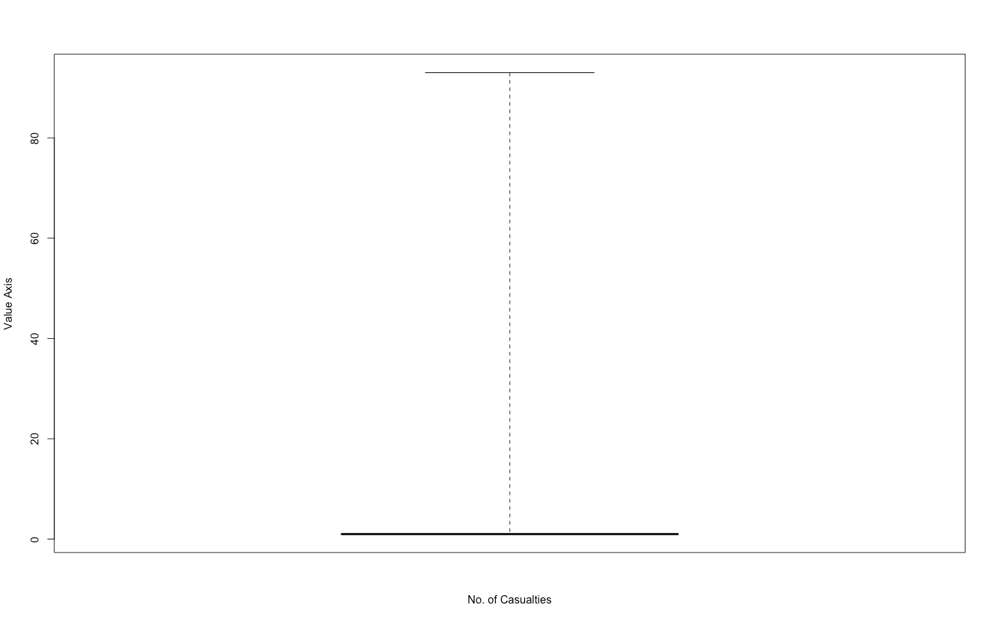
Main Code For the boxplot:-
> boxplot(r$Number_of_Casualties, col="Yellow", range=0, ylab="Value Axis", xlab="No. of Casualties")

Slide 45
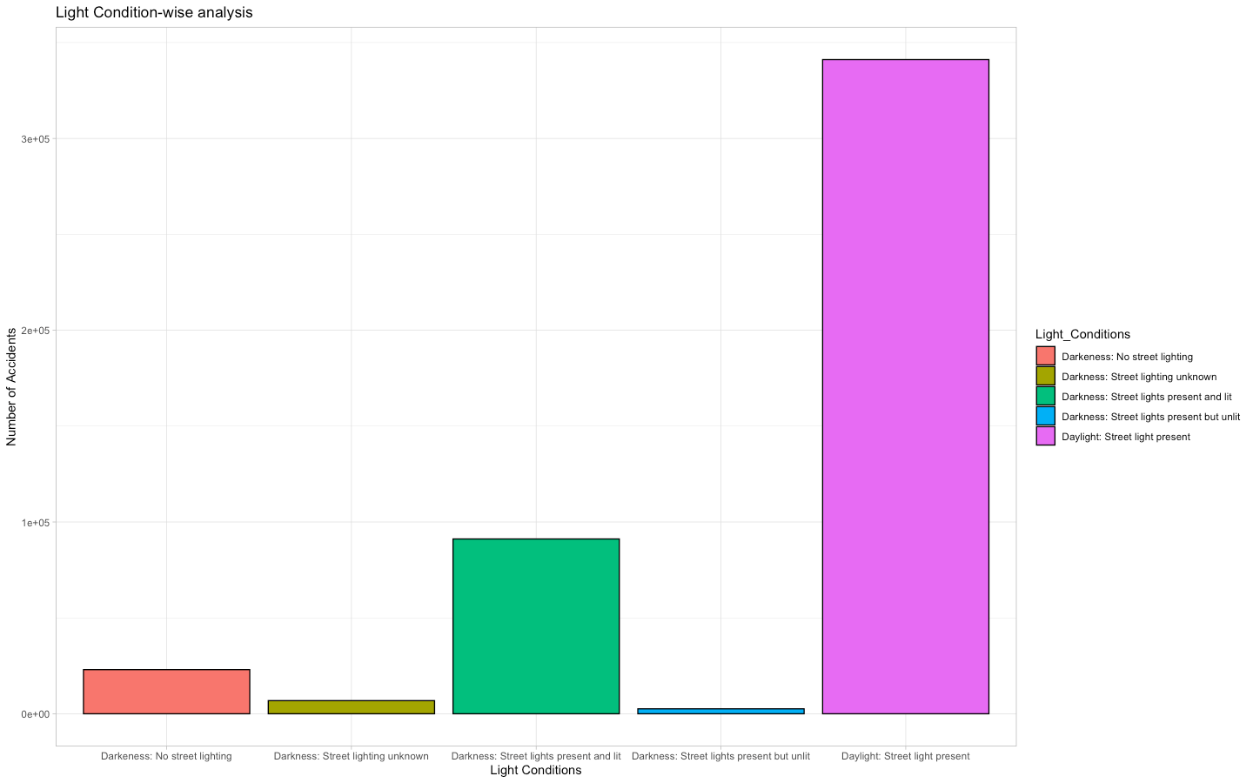
Accidents analysis according to Light Conditions:-
> ggplot(r, aes(Light_Conditions, fill=Light_Conditions))+geom_bar(color="black")+labs(x="Light Conditions", y="Number of Accidents", title="Analysis of Accidents As per light conditions")+theme_light()

Slide 46
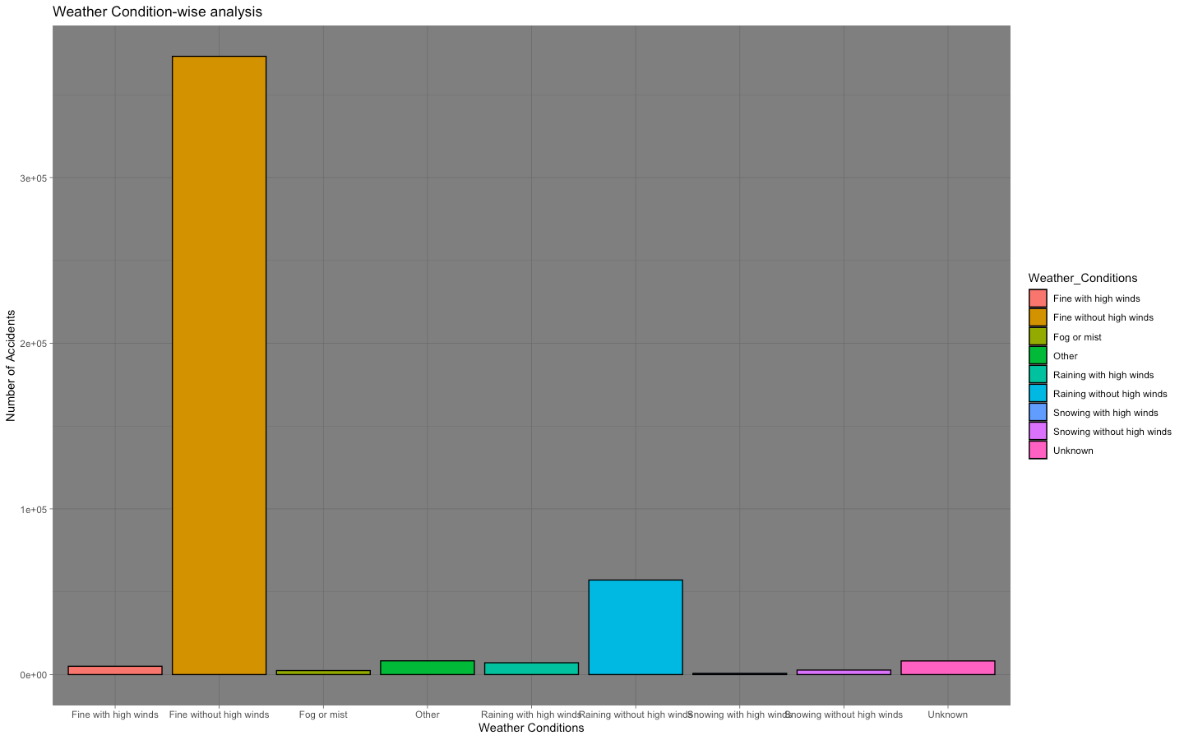
Accidents according to Weather conditions:-
> ggplot(r, aes(Weather_Conditions, fill=Weather_Conditions))+geom_bar(color="black")+labs(x="Weather Conditions", y="Number of Accidents", title="Weather Condition-wise analysis")+theme_dark()

Slide 47
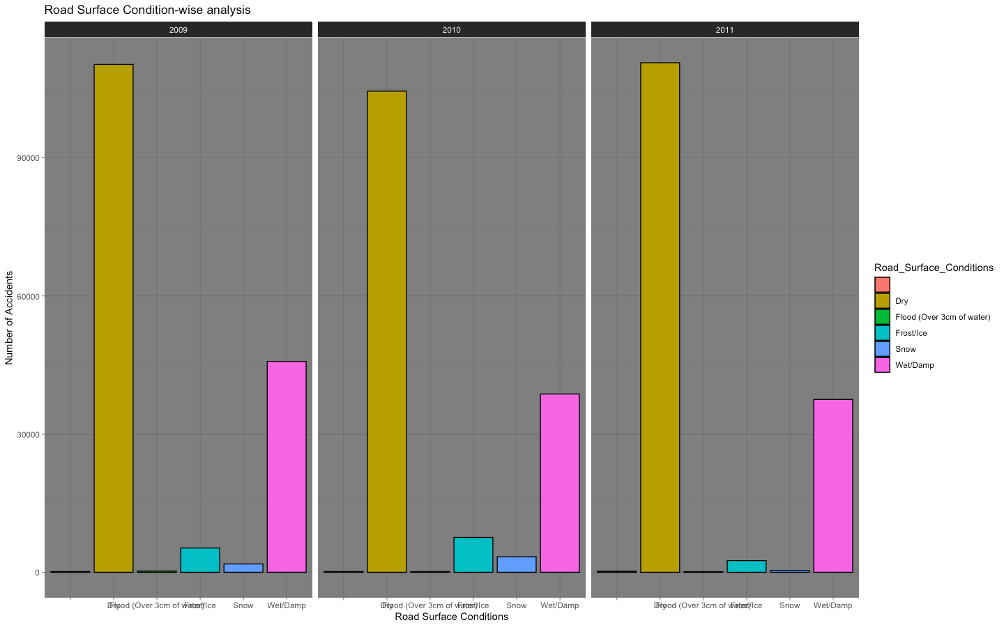
Accidents according to the Road Surface Conditions:-
> ggplot(r, aes(Road_Surface_Conditions, fill=Road_Surface_Conditions))+geom_bar(color="black")+labs(x="Road Surface Conditions", y="Number of Accidents", title="Road Surface Condition-wise analysis")+facet_wrap(r$Year)

Slide 48
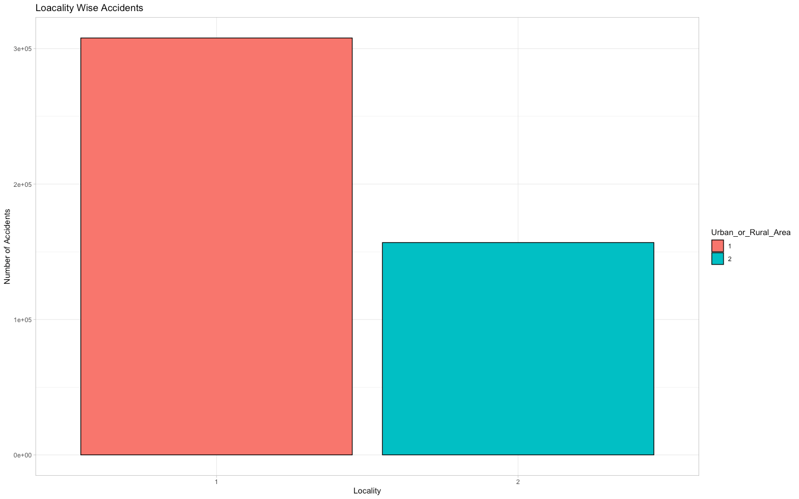
Location analysis of Accidents (In urban or Rural Locality):-
> ggplot(r, aes(Urban_or_Rural_Area, fill=Urban_or_Rural_Area))+geom_bar(color="black")+labs(x="Locality", y="Number of Accidents", title="Loacality Wise Accidents")+theme_light()

Slide 49
If the Police officer attended the scene or not:-
> ggplot(f, aes(Did_Police_Officer_Attend_Scene_of_Accident, fill=Did_Police_Officer_Attend_Scene_of_Accident))+geom_bar(color="black")+labs(x="Police Attended or not", y="Number of Accidents", title="If Police Attended the scene or not")+theme_light()

Slide 50
FINAL CONCLUSION ON THE BASIS OF THE ABOVE THREE FILES:-
Total number of accidents from 2005 to 2014 are:-
>nrow(f)+nrow(p)+nrow(r)
[1] 1504150
Total number of casualties in all these accidents were:-
>sum(f$Number_of_Casualties)+sum(p$Number_of_Casualties)+sum(r$Number_of_Casualties)
[1] 2031817
Maximum accidents happened in the set of years from 2005 to 2007 i.e. 570011.
In most of the accidents, the number of casualties were 1.
In most of the accidents, the number of vehicles involved were 2.
Maximum number of accidents happened on Saturday.
In most of the accidents, the road surface condition was dry.

Slide 51
In most of the accidents, the weather condition was fine with no winds.
In most of the accidents, the light condition was daylight with street lights present.
Most of the accidents happened in the urban areas.
There is decrease in accidents with all these years.
Most of the accident sites were visited by a police officer.

Slide 52
Geo Mapping
For performing geomapping, we need the following packages.
RgoogleMaps
ggmap
mapproj
sf
dplyr
OpenStreetMap
devtools

Slide 53
Steps to Perform Geo Mapping
Step1. For geo mapping is loading all the required packages in the library.
Step 2. Checking the starting and ending latitudes and longitudes of the country or place you need to plot the map for.
Step 3. Create an google API Key.
Step 4. Now set your key following this syntax.
Syntax:-
ggmap::register_google(key = "SET YOUR KEY HERE")
NOTE:- ggmap function cannot be used without the API key.
Step 5. Making the map and storing it into a variable.
Syntax:-

Slide 54
p <- ggmap(get_googlemap(center = c(lon = -122.335167, lat = 47.608013),zoom = 11, scale = 2,maptype ='terrain',color = 'color'))
Step 6:- Now, consider the points you want to plot on the made map.
Step 7:- Follow the following syntax for plotting these points on your map.
Syntax:-
p + geom_point(aes(x = Longitude, y = Latitude, colour = Initial.Type.Group), data = i2, size = 0.5) +
theme(legend.position="bottom")
This will plot all the points on the map using their latitudes and longitudes.
Another way which we used is by using the OpenStreetMap function.
Code:-
>uk

Slide 55
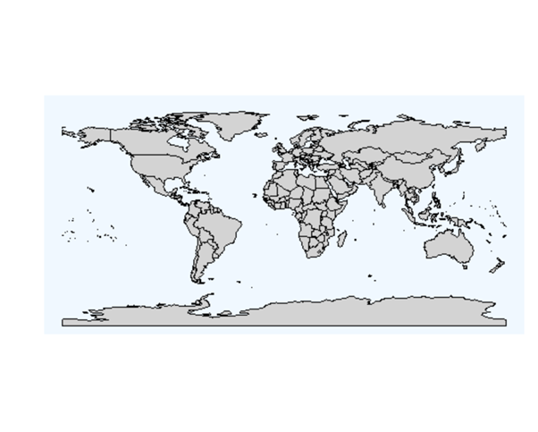
WORLD MAP USING OPEN STREET MAP
plot(worldmap, col="lightgrey", fill=T, border="black", xlim=c(-180,180), ylim=c(-90,90), bg="aliceblue", asp=1, wrap=c(-180,180))

Slide 56
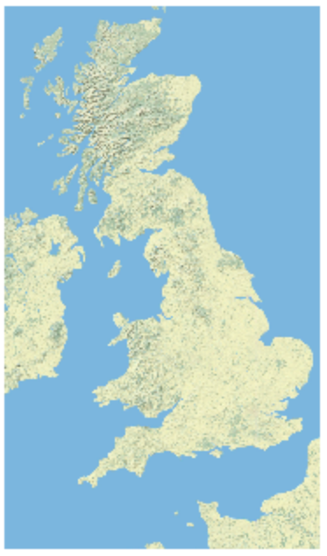
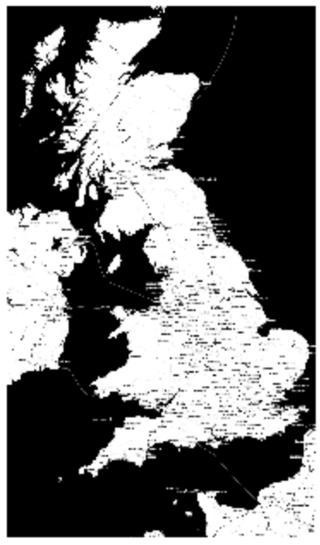
Another way which we used is by using the OpenStreetMap function.
uk<-openmap( c(61,-8), c(45,2), type="nps", minNumTiles = 50 , zoom=NULL)
> plot(uk)
> uk<-openmap( c(61,-8), c(45,2), type="stamen-toner", minNumTiles = 50 , zoom=NULL)
> plot(uk)

Slide 57
THANK-YOU !
SUBMITTED BY:-
ANANYA
ANIRUDH KASHYAP

